Slide 1
Fundamental interaction

Slide 2
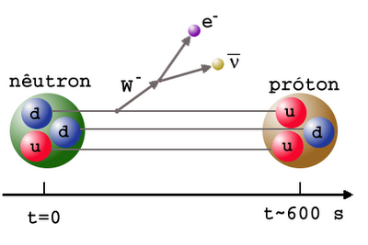

Slide 3
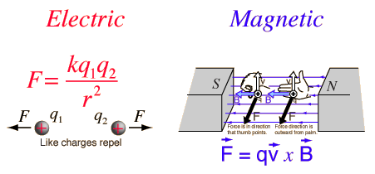

Slide 4
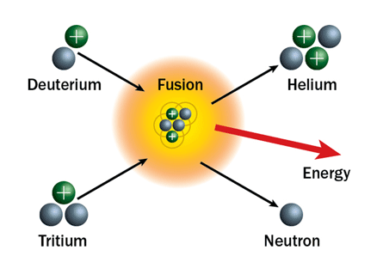

Slide 5
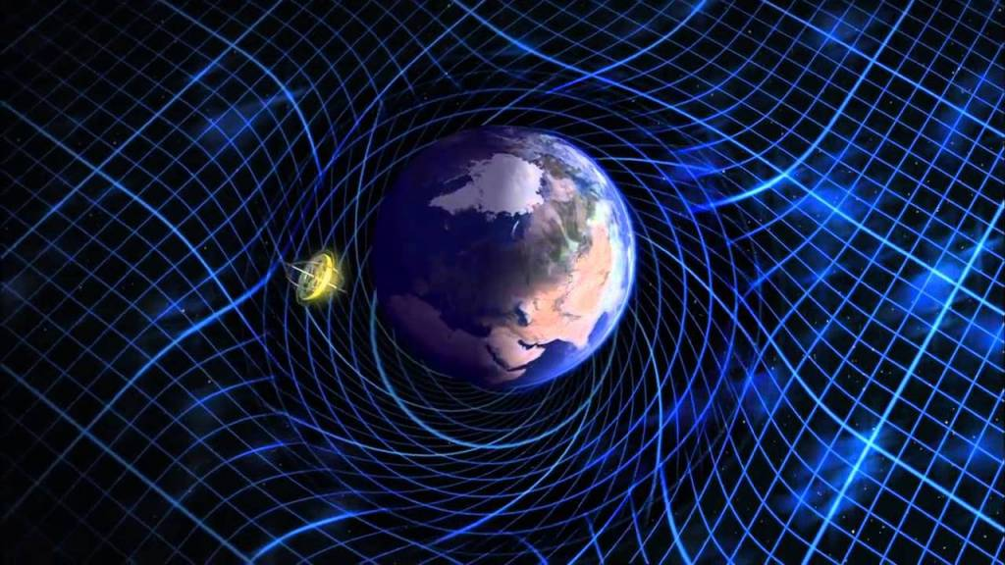

Slide 6
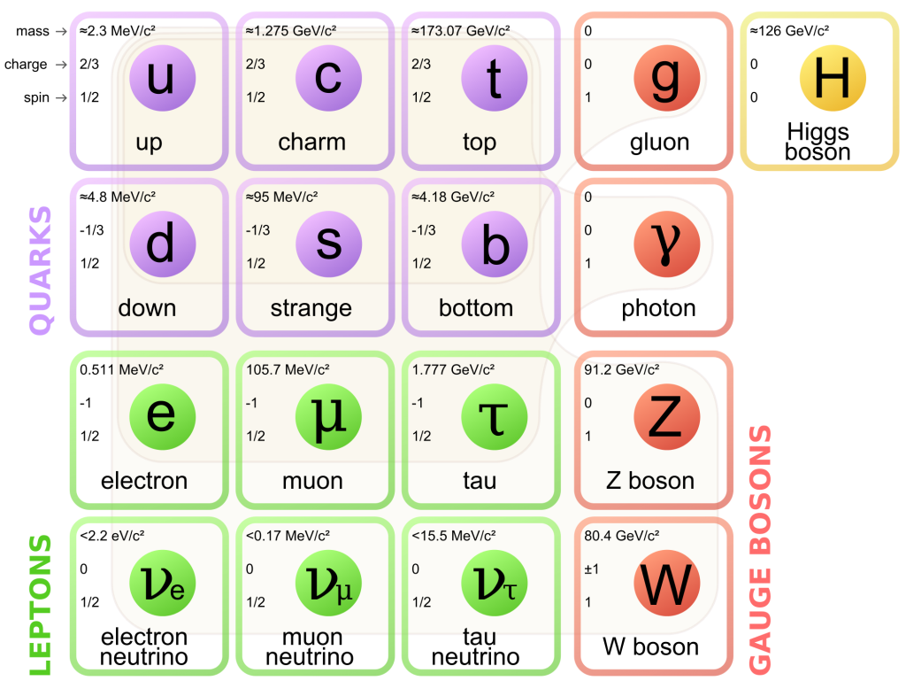

Slide 7
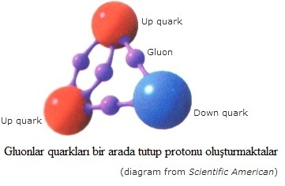

Slide 8

Interaction | Current Theory | Mediators | Relative Strength^{[1]} | Long-Distance Behavior | Range(m)
Strong | Quantum chromodynamics (QCD) | gluons | 10³⁸ | (see discussion below) | 10⁻¹⁵
Electromagnetic | Quantum electrodynamics (QED) | photons | 10³⁶ |  | infinite
Weak | Electroweak Theory | W and Z bosons | 10²⁵ |  | 10⁻¹⁸
Gravitation | General Relativity (GR) | gravitons (not yet discovered) | 1 |  | infinite

Slide 9
Interaction | Current Theory | Mediators | Relative Strength^{[1]} | Long-Distance Behavior | Range(m)
Strong | Quantum chromodynamics (QCD) | gluons | 10³⁸ | (see discussion below) | 10⁻¹⁵
Electromagnetic | Quantum electrodynamics (QED) | photons | 10³⁶ |  | infinite
Weak | Electroweak Theory | W and Z bosons | 10²⁵ |  | 10⁻¹⁸
Gravitation | General Relativity (GR) | gravitons (not yet discovered) | 1 |  | infinite

Slide 10
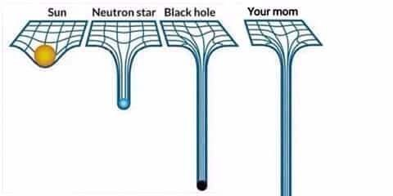
F=qE+qv×B

Slide 11
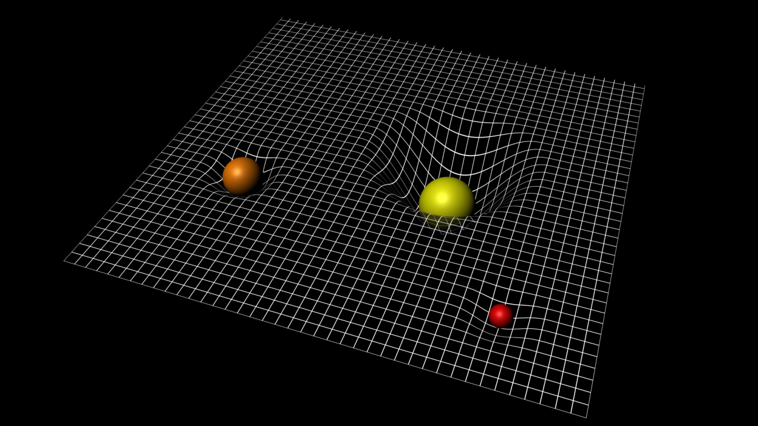

Slide 12
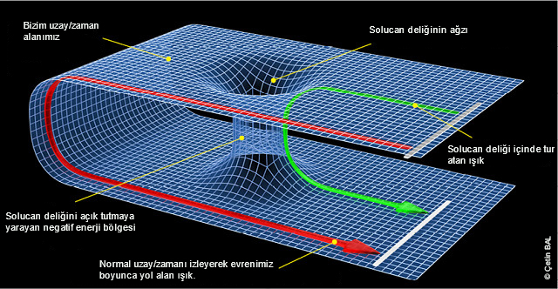

Slide 13
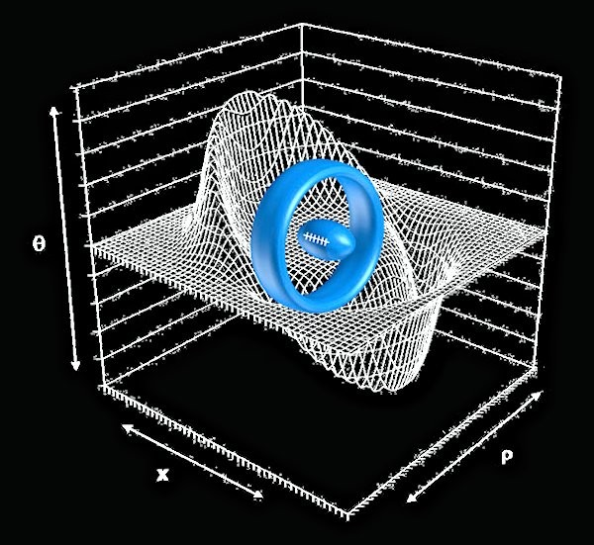
WARP Engine

Slide 14
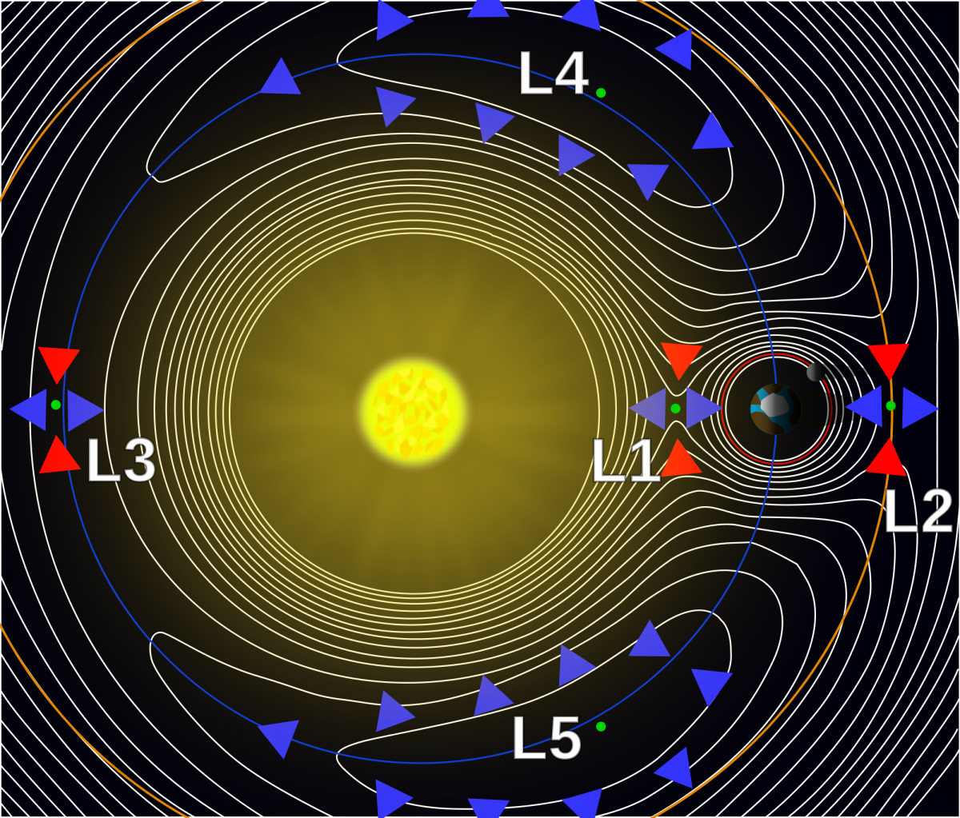

Slide 15
